Slide 1
Electrical
and Electronics science
First year
Computer Science and Engineering
Dr. Shakti Singh
ASSISTANT PROFESSOR
ELECTRCIAL AND INSTRUMENATION
ENGINEERING DEPARTMENT
@shakti.singh@thapar.edu

Slide 2
Diode Circuits or Uncontrolled Rectifier
Rectification: The process of converting the alternating voltages and currents to direct currents

Slide 3
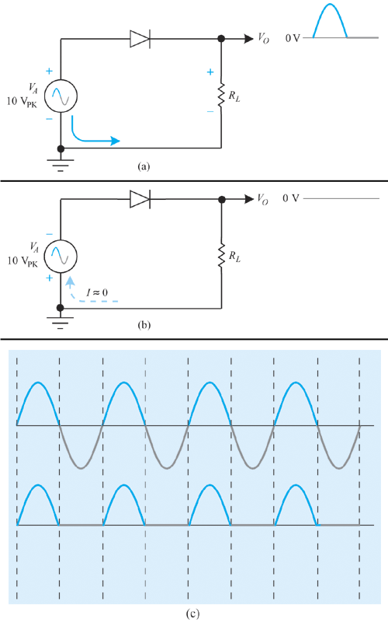
Half-wave Rectifier
The term rectify is used to describe the conversion of ac into dc.
In the circuit shown, only one-half of the input waveform is allowed to pass through to the output.
This is called half-wave rectification.

Slide 4
Circuit Operation
During the positive alternation, the diode is forward biased and the full applied voltage is dropped across the load resistor.
During the negative alternation, the diode is reverse biased and acts like an open circuit. No voltage is present across the load resistor.
The output voltage is actually pulsating dc.
An application for a half-wave rectifier is shown on the following slide.

Slide 5
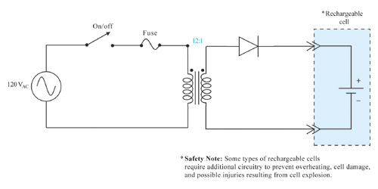
Circuit Operation

Slide 6
The main disadvantages of half wave rectifier are:
High ripple factor,
Low rectification efficiency,
Low transformer utilization factor
DC saturation of transformer secondary winding.

Slide 7
Performance Parameters
1.Rectification efficiency
2. Form factor
3. Ripple factor

Slide 8
5. Power factor

Slide 9
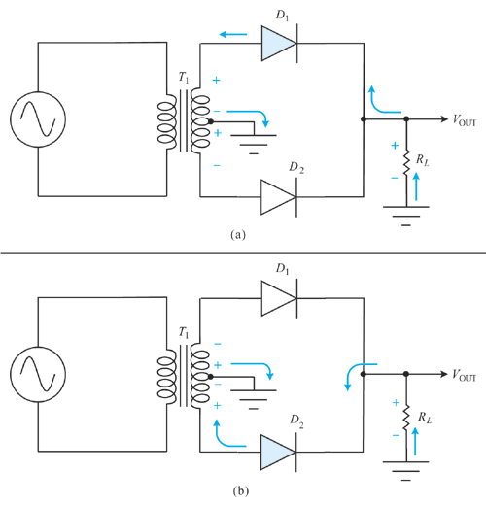
Full-wave Rectifier
A full-wave rectifier applies both halves of an ac waveform to the output.
The circuit shown is called a bi-phase half-wave rectifier and a center-tapped rectifier circuit.
Operation of a full-wave rectifier is demonstrated in the figure shown on the following slide.

Slide 10
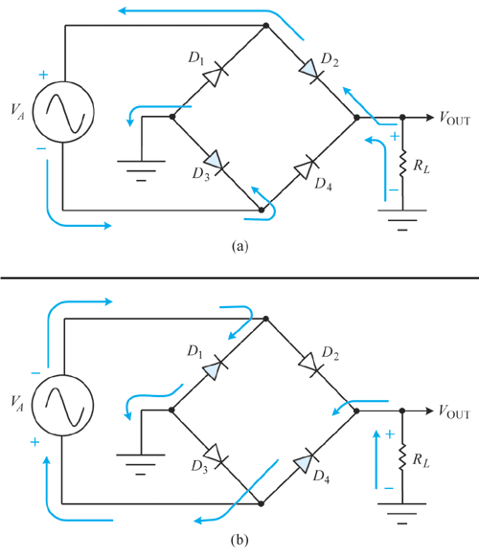
Bridge Rectifier
A bridge rectifier is more widely used than the center-tapped rectifier.
Circuit operation is best understood by examining the current paths of the forward and reverse biased diodes during each half-cycle of the input waveform.

Slide 11
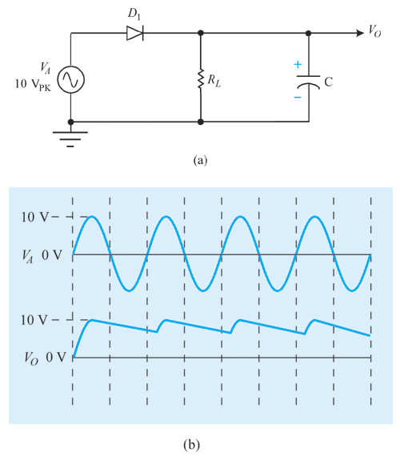
Filter Networks
Most electronic applications require smooth dc current to operate properly. Filtering pulsating dc circuits accomplishes this.
Adding a capacitor to the output of a half-wave rectifier filters the pulsating dc into smooth dc.

Slide 12
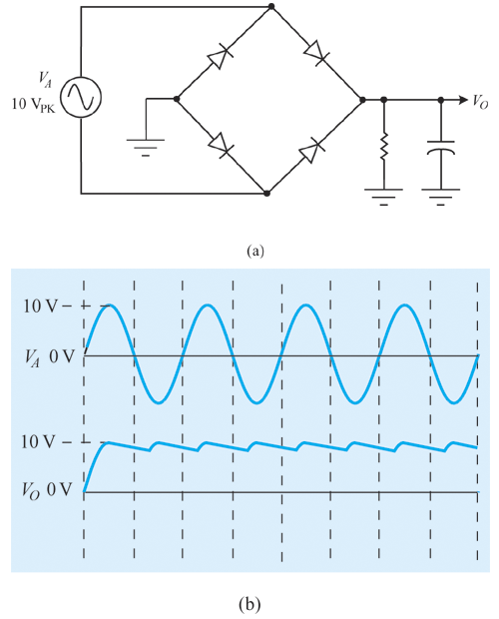
Full-wave Rectifier with Filter
A capacitive filter added to the output of a full-wave bridge rectifier is shown at the right.
One drawback of a half-wave rectifier is the higher level of ripple voltage after filtering. Full-wave rectification reduces this ripple voltage.

